Slide 1
ECE 901
Lecture 1
Large-scale Machine Learning
and Optimization

Slide 2
Intros
Instructor
Dimitris Papailiopoulos
dimitris@papail.io dimitris@ece.wisc.edu
Times
Tu. + Thu. @ 1:00 - 2:15pm
Office Hours:
Just send an email,
and we’ll arrange a mutually convenient time.
Webpage:
papail.io/901

Slide 3
Material
The course is based on recent books and text on ML, OPT and systems
Everything online:
papail.io/901
Books
Papers
Lecture Notes
Slides

Slide 4
Overview
Why Machine Learning?
Why Large-Scale?
Why Optimization?
What we will cover?
Logistics
Grading

Slide 5
Why Machine Learning?

Slide 6
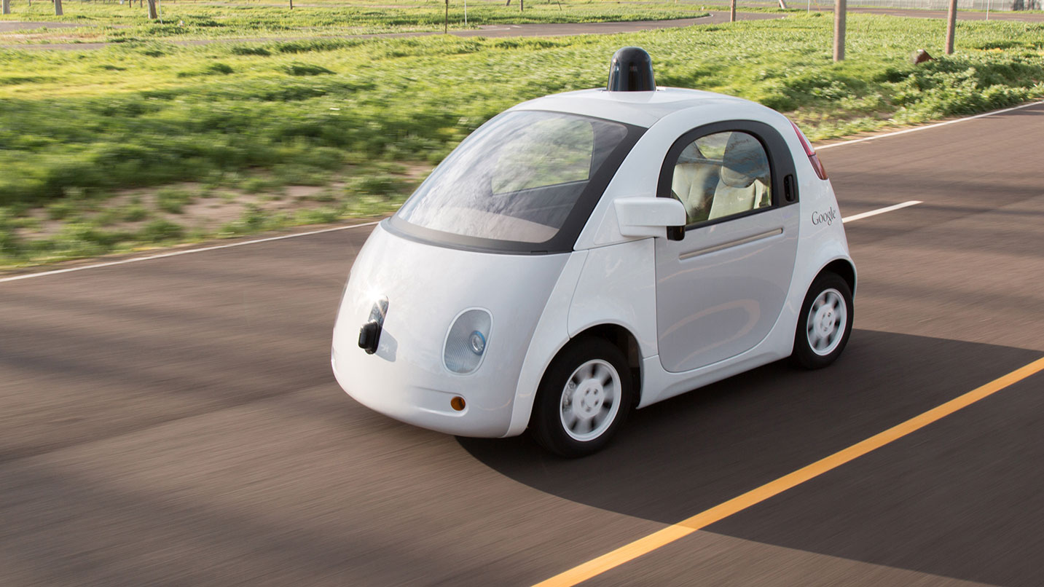
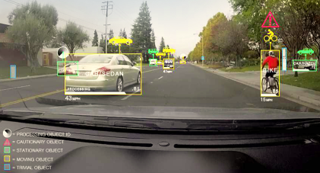
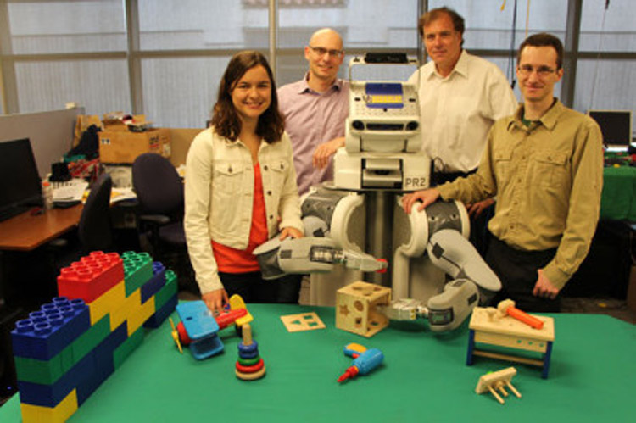
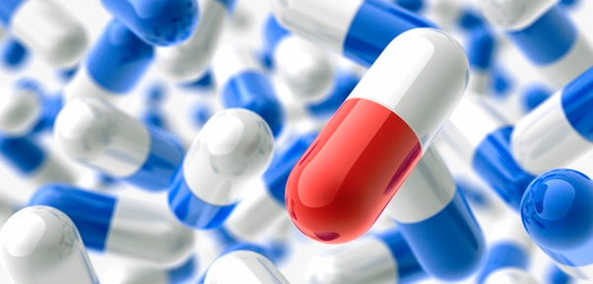


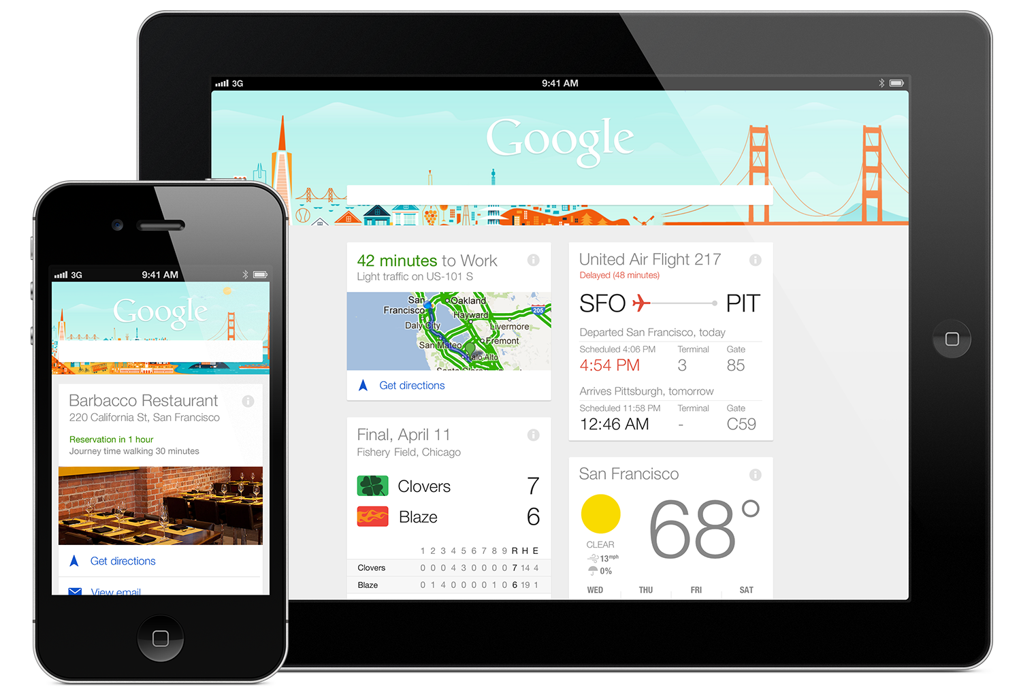
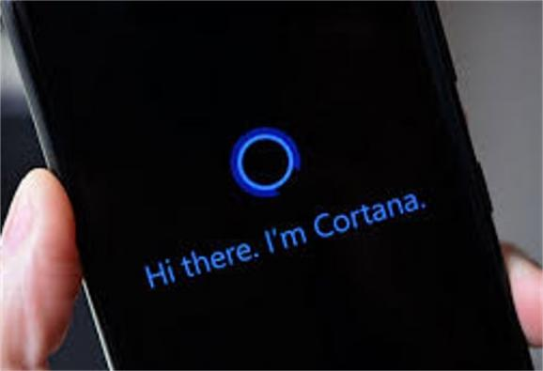



Automation and Robotics
Drug Discovery and Healthcare
Real and Important Problems
Intelligent Personal Assistants
Recommender Systems

Slide 7







Real Jobs

Slide 8
Why Large-scale?

Slide 9

Content Generation
More than 700 photos uploaded / second
We have to handle large data sets
More than 7k tweets / second
More than 55K google searches / second
More than 2.5 million emails sent / second
[Source: http://www.internetlivestats.com/one-second/]

Slide 10
Why Optimization?
Small Detour
The Machine Learning Pipeline

Slide 11






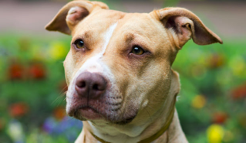
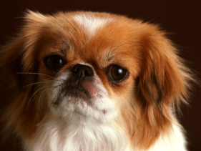

What is a “regular” ML pipeline?
Running example: image classification
Goal:
“train a computer to recognize a cat from a dog”
How?

Slide 12
What is a “regular” ML pipeline?
Running example: image classification
Goal:
“train a computer to recognize a cat from a dog”
How?
Simple idea, inspired by inductive human learning
Show it a lot of labeled examples
“predicts” the right label on unseen data

Slide 13
To this
From This

Slide 14
What is a “regular” ML pipeline?
Running example: image classification
Goal:
“train a computer to recognize a cat from a dog”
How?
Input Data

Slide 15
What is a “regular” ML pipeline?
Running example: image classification
Goal:
“train a computer to recognize a cat from a dog”
How?
Input Data
Training

Slide 16
What is a “regular” ML pipeline?
Running example: image classification
Goal:
“train a computer to recognize a cat from a dog”
How?
Input Data
Training
Model

Slide 17
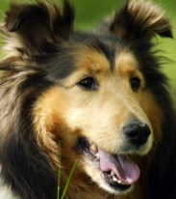
What is a “regular” ML pipeline?
Running example: image classification
Goal:
“train a computer to recognize a cat from a dog”
How?
Test (unseen) Data
Input Data
Training
Model
predicted
label:
“dog”

Slide 18
ML Pipelines
Test Data
Input Data
Feature
and Model Selection
Training
Model

Slide 19
ML Pipelines
Test Data
Input Data
Feature
and Model Selection
Training
Model

Slide 20
Feature Selection
Feature space
Pointy Ears
Size
Goal: Use “informative” features

Slide 21
Choose your predictor
(hypothesis class)
Goal: Pick a predictor that is
1) expressive 2) easy to train 3) doesn’t overfit

Slide 22
ML Pipelines
Test Data
Input Data
Feature
and Model Selection
Training
Model

Slide 23
Then you train it
Feature space
Pointy Ears
Size
Goal: Train a model to minimizes training error

Slide 24
Then you train it
Feature space
Pointy Ears
Size
Goal: Train a model to minimizes training error

Slide 25
Then you train it
Feature space
Pointy Ears
Size
Goal: Train a model to minimizes training error

Slide 26
Then you train it
Feature space
Pointy Ears
Size
Goal: Train a model to minimizes training error

Slide 27
Then you train it
Feature space
Pointy Ears
Size
Goal: Train a model to minimizes training error

Slide 28
ML Pipelines
Test Data
Input Data
Feature Selection
Training
Model
Google’s deep nets can take 100s hrs to train
[Dean et al., 2012]

Slide 29
Questions?

Slide 30
Why Optimization?

Slide 31
Training via Optimization
Many Problems in ML can be written as
Why?

Slide 32
The goal of Training
What we have: Labeled examples presented as (features, label)
E.g., features = image, label = “cat” (-1), or “dog” (+1)
Assumption:
all labeled (train/test) examples come from unknown distribution
+1

Slide 33
The goal of Training
What we have: n labeled examples drawn i.i.d. from
What we want: Train a model (a predictor function f )
That performs well on unseen data.
E.g.,

Slide 34
The goal of Training
What we have: n labeled examples drawn i.i.d. from
What we want: Train a model (a predictor function f )
That performs well on unseen data.
E.g.,
Our trained predictor

Slide 35
The goal of Training
How to measure performance?
Goal:
We want a predictor f with small loss on unseen data (e.g., on the test set)
Examples:
Measures disagreement between
predicted and true label
But, we haven’t seen… unseen examples

Slide 36
The goal of Training
The loss on the “unseen” examples convergences to the expected loss
What else converges to the expected loss?
Note: More details in next lecture
Expected/True risk
Empirical risk

Slide 37
Training via Optimization
We want to solve:
We instead solve the ERM:
Note: More details in next lecture
e.g., F can be:
separating hyperplanes
NNs of depth-t
…

Slide 38
Training via Optimization
More often than not, ERM can be written as
Note: Several examples in next lecture.
Measures model fit
for data point i
(avoids under-fitting)
Measures model
“complexity”
(avoids over-fitting)

Slide 39
Questions?

Slide 40
Scalability

Slide 41
Solvability ≠ Scalability
Many of the problems that we visit, can be solved in polynomial time, but that’s not enough.
E.g.,
O( #examples^4 * dimension^5 ) not scalable
We need fast algorithms!
Ideally O(#examples * #dimension) time
We want algorithms amenable to parallelization!
if serial runs in O(T) time, we want O(T/P) on P cores.

Slide 42
Performance Trade-off
We want our algorithms to be here
stat. accuracy
speed
parallelizability

Slide 43
Contents and Goals

Slide 44
This course
Algorithms / Optimization
Statistics
Systems

Slide 45
What will we cover?
Part 1: (~1 month)
ERM and Optimization (convex / nonconvex)
Convergence properties of SGD and Variants
Generalization performance, Algorithmic Stability
Neural Nets
Part 2: (~ 1 month)
System Tradeoffs and Platforms (multicore, distributed, numa…)
Multicore and Distributed Optimization
Serializable Machine Learning
Stragglers in Distributed Computation
Part 3: (~ 1 month)
Unsupervised Learning (PCA, clustering, …)
Dimensionality reduction
Semidefinite and Linear Programs

Slide 46
Goals of this course
Learn new algorithmic tools for large-scale ML
Produce a research-quality project report

Slide 47
Questions?

Slide 48
Grading Logistics

Slide 49
Grading
No HWs
No Written Exams

Slide 50
Grading
1. Research Project – 50%
Paper Presentations – 30%
Scribing – 15%
Student Participation – 5%

Slide 51
Semester Project (50%)
Milestones:
Part 1: (15%)
Mid-semester proposal (due ~week #9-10)
Proposal presentation and feedback day.
Part 2: (35%)
End-semester report (due Dec 15)
What can it be?
An open problem relevant to your research and the course
An open problem relevant to the course

Slide 52
Paper Presentations (30%)
Frequency:
Every 2 weeks, starting ~ week #5
Total of 4-5 presentations
Format:
Groups of 2-4
15 minutes long
Content:
Every 2 weeks list of papers posted
Groups will rate papers (1-5)
A max-weight matching will determine assignment

Slide 53
Scribing (15%)
Frequency:
Every lecture starting lecture #2
Due 1 week after each lecture
Format:
Groups of #students / #lectures
One group / lecture
(everyone has to scribe once)
LaTeX template

Slide 54
Student Participation (5%)
Students expected to participate with questions, and comments.
Small project updates during semester.
Other in-class activities.

Slide 55
Grading
1. Research Project – 50%
Paper Presentations – 30%
Scribing – 15%
Student Participation – 5%

Slide 56
Pre-Reqs
Linear Algebra
Probability
Basic concepts of optimization and ML

Slide 57
Questions?

Slide 58
Quiz

